Slide 1

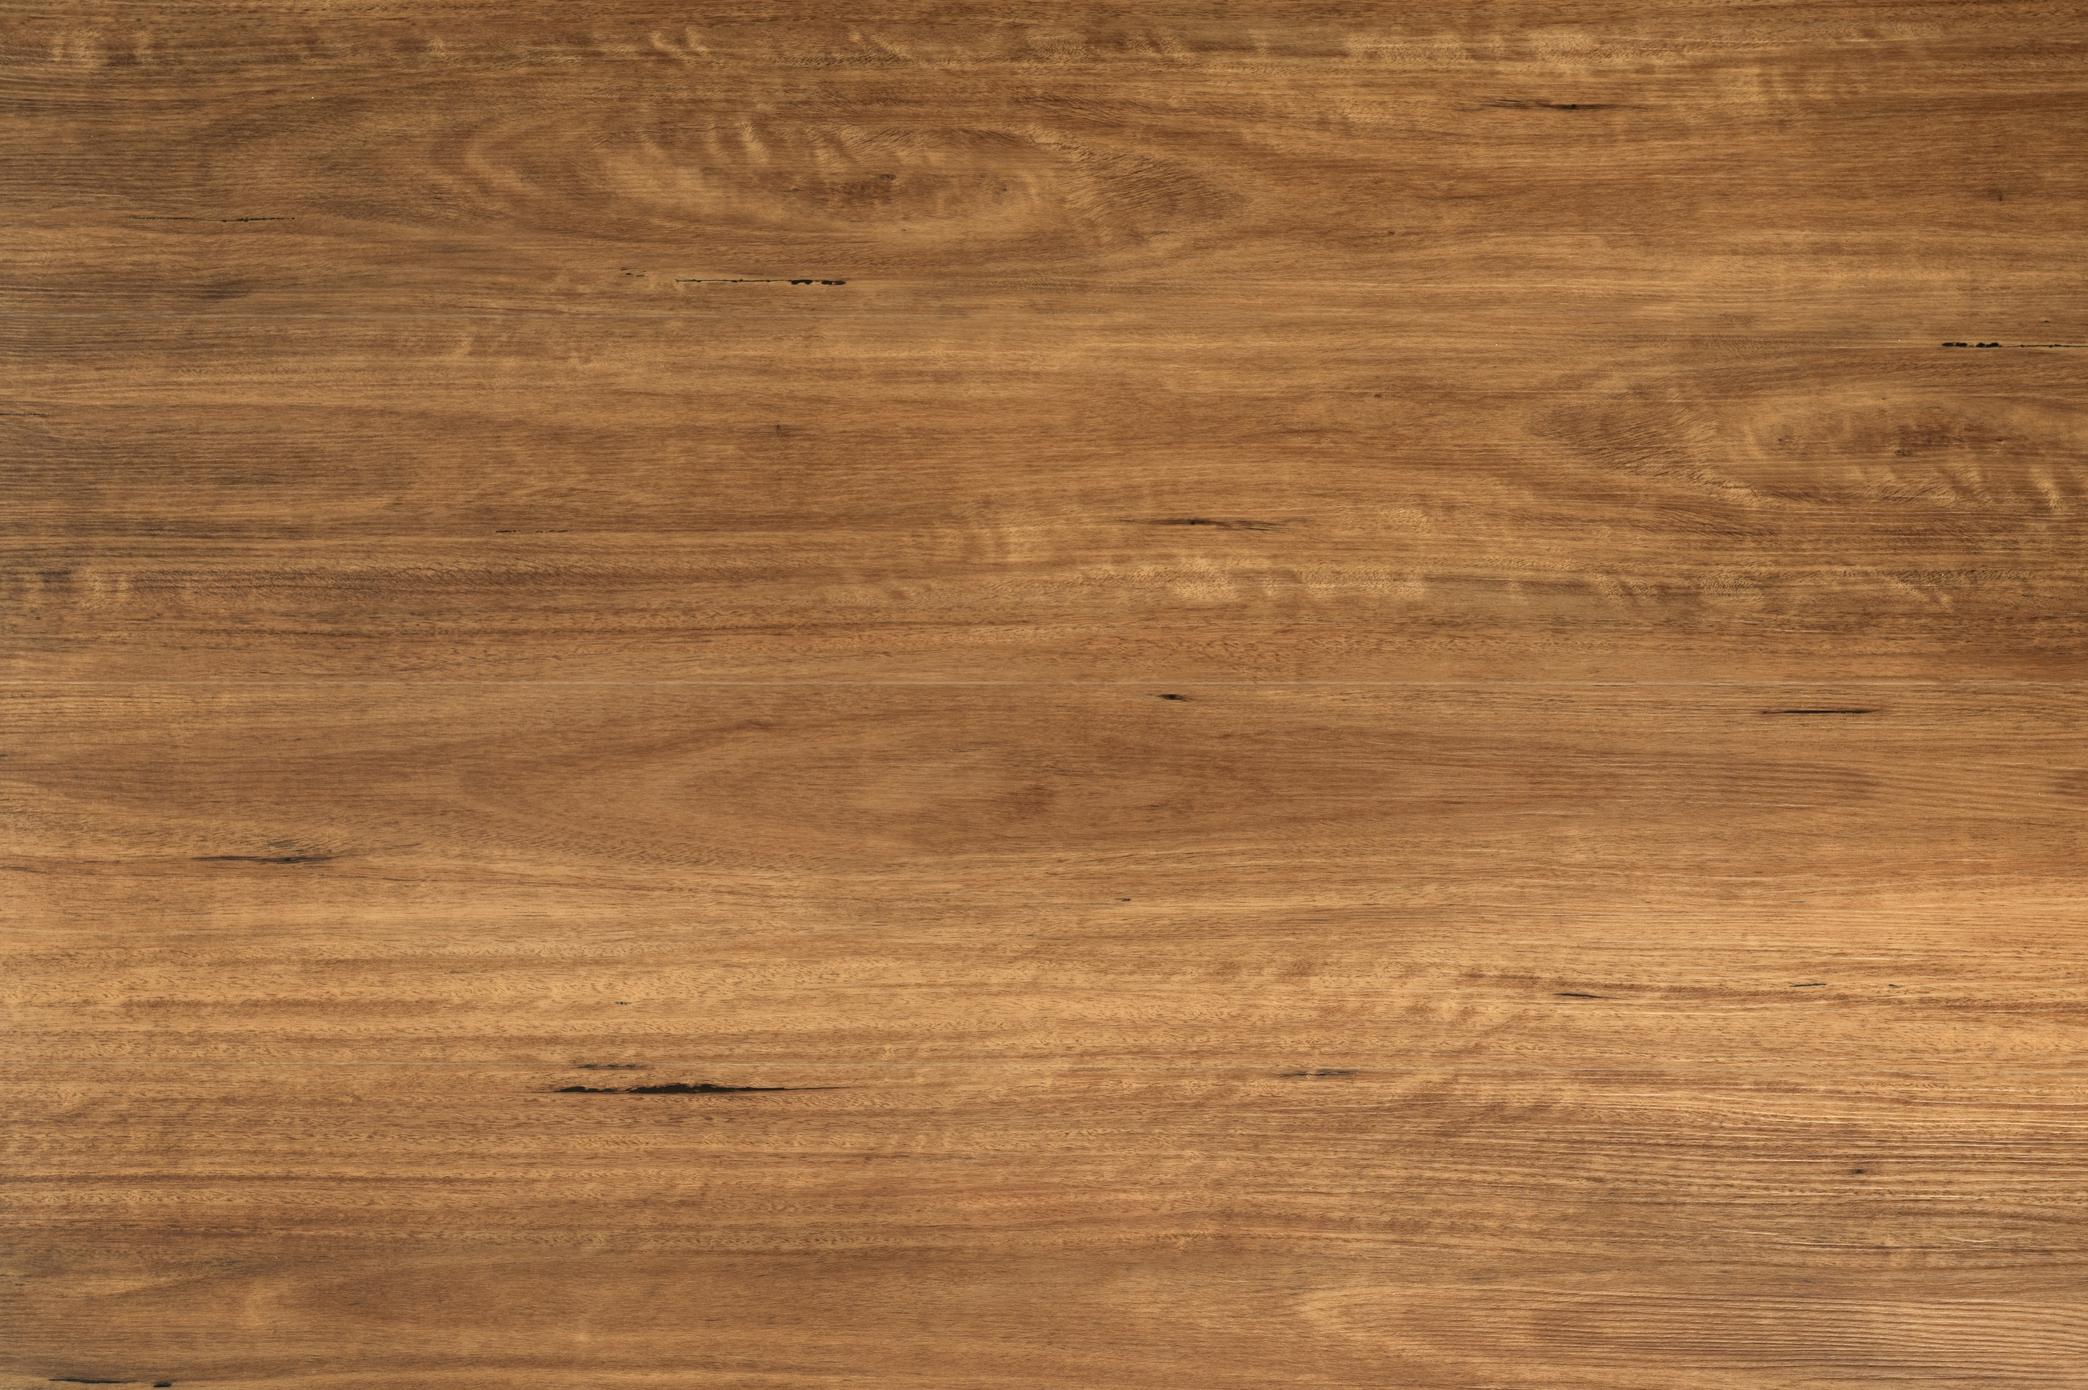
SPOTTED GUM (waterproof)
HYBRID SPC FLOORING
Structure | Stone & Plastic Composite
Size | 1800*228*8 mm
Pack Size | 1.642 sqm/pack
Profile | Click System
Finish | Matt, UV
Edge | Micro Bevel
Installation Method | Floating
Fire Test (AS/ISO 9239.1-2003) | CHF Value 10.2 kW/m² Smoke Value90% min
Slip Resistance Classification | P3 SA 4586-2013 Appendix A
Acoustic Rating | 5 Star
Wear Layer Domestic Warranty | 5 Years
Structural Domestic Warranty | 25 Years
Disclaimer
Product baches, variations can occur between samples, in showroom displays and printed and online imagery. Please ensure you review your sales order and the actual product PRIOR to your flooring being installed as although we endeavor to represent our products to the best of our ability this natural variation can cause differences.

Slide 2
Product Detail
Premium Range – Hybrid SPC
Brand | Quality Flooring
Colour | Spotted Gum
Material | Stone and Plastic composite
Plank Size | 1800*228*8 mm
Thickness | 8 mm
Ware Layer | 0.5 mm
Finish & Feature | Matt UV, Waterproof
Joint Profile | Click System
Installation Method | Floating
Acoustic Rating | 5 Star
Slip Resistant | P3
Wear Layer Domestic Warranty | 5 Years
Structural Domestic Warranty | 25 Years

