Slide 1

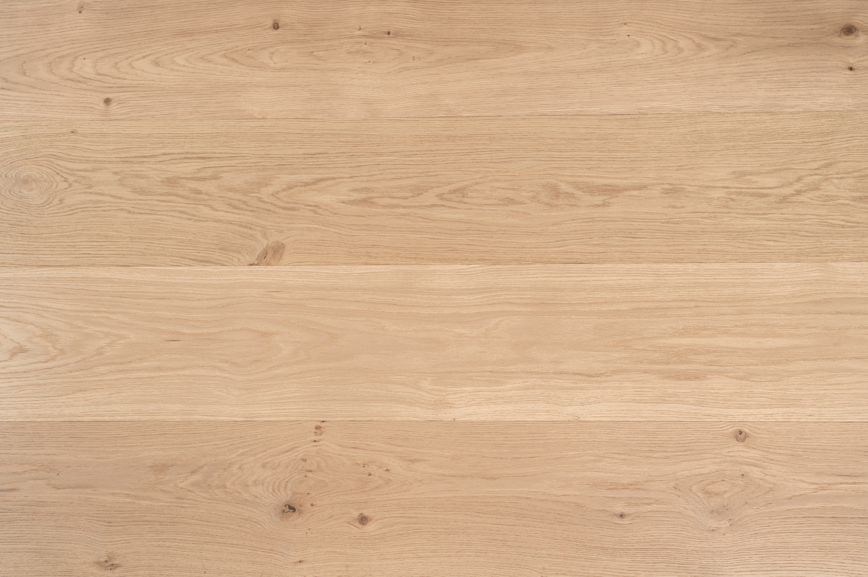
SANDY OAK
EUROPEAN ENGINEERED OAK
Wood Species | European Oak
Size | 14/1.2*190*1900 mm (1.2mm veneer) 15/4*260*2200 mm (4mm veneer)
Pack Size | 2.166 sqm or 2.86 sqm per pack
Short Boards | 30%
Grading | ABCD
Profile | Tongue & Groove
Finish | Matt, UV Lacquer, Water Resistance
Installation Method | Direct Stick, Floating
Fire Test CHF Value | Mean 5.3 kW/m² (AS/ISO 9239.1-2003)
Fire Test Smoke Value | Mean 35% min (AS/ISO 9239.1-2003)
Slip Classification | P3 (AS 4586-2013 Appendix A)
Wear Layer Domestic Warranty | 5 Years
Structural Domestic Warranty | 25 Years
Disclaimer
As timber is a natural product, variations can occur between samples, in showroom displays and printed and online imagery. Please ensure you review your sales order and the actual product PRIOR to your flooring being installed as although we endeavor to represent our products to the best of our ability this natural variation can cause differences.

